Slide 1
Preventing Cybersecurity Events In The ASC
Iowa Association of Ambulatory Surgery Centers
10th Annual Conference
April 6th, 2018

Slide 2
Agenda
Learning objectives
Cybersecurity overview
Importance of prevention
Preventative measures
Guidance for improvement

Slide 3
Learning Objectives
EDUCATION
What is cybersecurity and why is it relevant to your ASC?
PLANNING
Take a proactive stance to protect your information assets.
APPLICATION
What things should you be doing and not doing today?

Slide 4
Cybersecurity
(noun)
The protections taken to keep electronic information private and safe from damage or theft.

Slide 5
Why is healthcare a target?
“Every year is becoming a record setting year for the number of security breaches that occur in healthcare organizations.” ICE Technologies
PHI
(Protected Health Information)
PII
(Personally Identifiable Information)
&

Slide 6
Where are businesses today?
ASC
Specific Incidents
Cyber crime damages expected to cost the world $6 trillion annually by 2021 — making it more profitable than the global trade of all major illegal drugs combined.
Source: CSO
Healthcare Specific Incidents
High-profile Business Incidents

Slide 7
Importance of Prevention

Slide 8
Why is preventing cybersecurity incidents important?
HIPAA / HITECH
Ensure the confidentiality, integrity, and availability of all e-PHI.
Identify and protect against reasonably anticipated threats.
Protect against reasonably anticipated, impermissible uses or disclosures.
Ensure compliance by their workforce.
Sanctions and penalties.
Administrative Safeguards
Physical Safeguards
Technical Safeguards

Slide 9
Why is preventing cybersecurity incidents important?
Protecting Key Applications
Patient Accounting, EHR, etc.
Email
Shared Files

Slide 10
Why is preventing cybersecurity incidents important?
Cyber Liability Insurance
Helps businesses survive breaches and attacks by paying for recovery expenses (customer notification, credit monitoring, legal fees, and fines).
First-party coverage covers expenses when your network is hacked or your data is stolen.
Third-party coverage offers protection when a customer or partner sues you for allowing a data breach to happen
Coverage levels should coincide with amount of PHI contained in systems

Slide 11
Preventative Measures

Slide 12
How to prevent a cybersecurity incident?
Be Prepared
It’s not a matter of “if” but “when”.
Realizing you have a problem is the first step.
Security is not just IT’s responsibility.
There’s no way to be 100% secure.
It can be overwhelming… but start with the basics.

Slide 13
How to prevent a cybersecurity incident?
Perform a Risk Analysis
A risk analysis is required by the HIPAA Security Rule.
Identify threats and vulnerabilities
Document existing security controls
Prioritize your risks
Provide guidance to remediate your risks

Slide 14
How to prevent a cybersecurity incident?
Require IT vendors to follow an IT security framework.
Identify
Protect
Detect
Respond
Recover

Slide 15
How to prevent a cybersecurity incident?
Implement and proactively manage foundational technology.
Firewalls
Desktop Protection
(Antivirus, Antimalware)
Encryption
(Devices & Email)
Backups
(Online, Offsite, Archive)

Slide 16
How to prevent a cybersecurity incident?
IT Policies - Examples
Acceptable Use
Password Management
Mobile Computing / Wireless
Incident Detection and Response
Backup and Recovery
Privacy and Data Protection

Slide 17
How to prevent a cybersecurity incident?
Staff Training
Create a culture of security.
Provide ongoing reminders
Audit compliance
Assess security awareness
Review and revise your policies and processes

Slide 18
Holes in the Defense

Slide 19
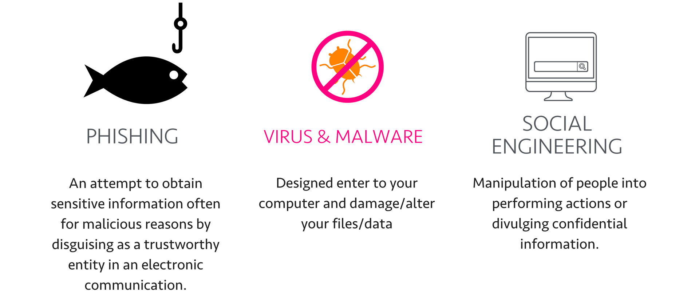
What can go wrong without basic protections?

Slide 20
What bad practices should be avoided?
Bad Practices
Not applying patches & software updates
Non-segregated Wi-Fi Networks
Unsupported
Software & Hardware
Removable
Media Devices

Slide 21
Key Takeaways

Slide 22
Improving your ASC’s cybersecurity position
1 - Don't assume your IT environment is protected
2 – Following good practices requires leadership
3 – Ask questions and seek understanding
4 – Review your IT environment annually
5 – Know your backup strategy and test the backups

Slide 23
Q&A
Contact Information:
Roy Georgia | 641.628.0286
rgeorgia@icetechnologies.com
Bret Shaw | 641.628.0206
bshaw@icetechnologies.com

