Slide 1
Bullying in the Medical Profession
Audrey Schroer, MPH
EAP Coordinator

Slide 3
Discussion Question: What comes to mind when you hear the phrase “Bullying in the workplace”?

Slide 4
Bullying by Definition: ^{[1]}
Is driven by the perpetrators’ need to control the target(s)
Involves acts of commission (doing things) and/or omission (withholding resources)
Causes consequences for the target
Undermines legitimate business interests
Is comparable to domestic violence at work

Slide 5
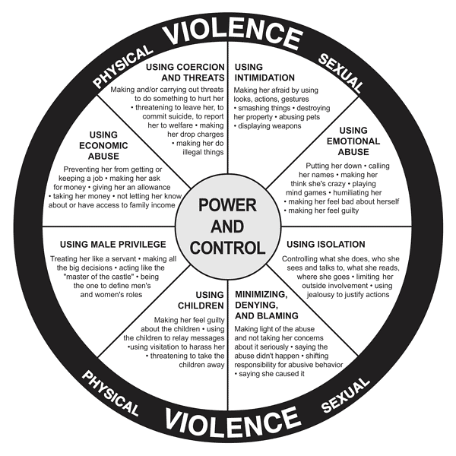
[2]
Notes:
Power and control wheel used to identify intimate partner violence, many power/control strategies used by perpetrators of intimate partner violence can be applied to workplace bullying.
Discussion question: Do you see any parallels between power/control behaviors in used by perpetrators of DV and bullying behavior at work? Which ones?

Slide 6
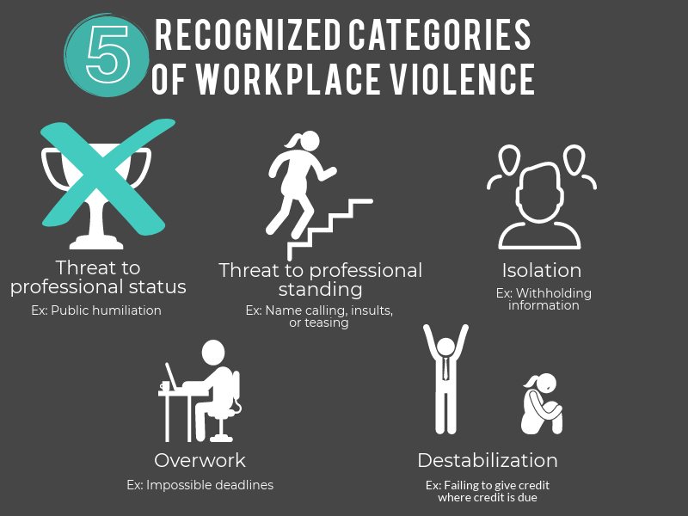

Slide 7
What are some examples of bullying at work? ^{[4]}
Spreading malicious rumors or innuendo
Excluding or isolating someone socially
Removing areas of responsibility without cause
Constantly changing work guidelines
Blocking applications for training, leave, or promotions
Establishing impossible deadlines that will set individual up to fail
Intruding on a person’s privacy by pestering, spying, or stalking
Underwork – creating a feeling of uselessness

Slide 8
“Reasonable Person” Test
If you are not sure an action or statement could be considered bullying, ask…
“Would most people consider the action unacceptable?” ^{[4]}
Notes:
Who is a “reasonable person” all people, people with our same job, or only within our profession?

Slide 9
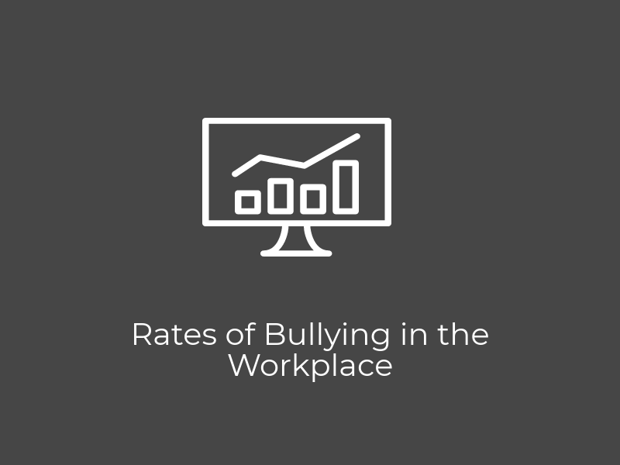

Slide 10
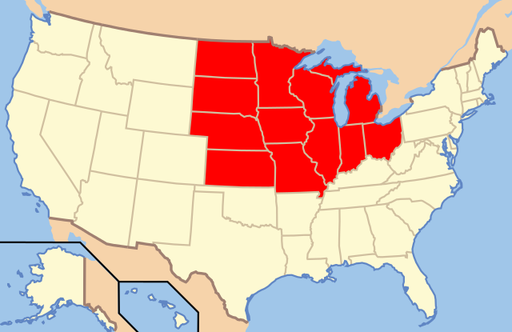
How Common is Workplace Bullying?
Workplace bullying impacts 60.4 million Americans ^{[5]}
19% of U.S. employee are bullied ^{[5]}
An additional 19% witness bullying
Workplace bullying is
4x more common in
the U.S. than illegal
Harassment ^{[6]}
Notes:
Ask group how common they think bullying is in the US

Slide 11
How Common is Bullying in the Medical Profession?
Working in the healthcare setting, 44% of nursing staff have been bullied ^{[7]}
21% of Nursing students and RNs report being physically assaulted at work ^{[8]}
Over 50% of healthcare staff report being verbally abused within the last 12 months ^{[8]}
Notes:
Discussion question: Compared to the general work force is bullying in healthcare higher, lower, or equal

Slide 12
Bullies and Targets ^{[5]}
Bullies
Targets
70% are men
61% are bosses
60% are women
20% suffer from adverse health affects related to bullying
65% lose their original job in the process of stopping bullying
Notes:
Bullying is not only bad for employees it impacts healthcare related costs for the business along with turnover related costs

Slide 13
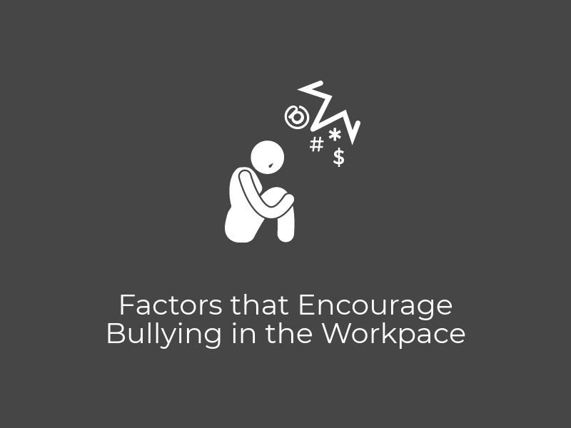

Slide 14
4 Factors that Promote a Culture of Bullying ^{[9]}
Currently there are no legal protections against workplace bullying
Only legal protections are through discrimination claim
Workplace cultures that encourage or enforce cutthroat competition
Hiring practices
Failing to contact manager’s previous subordinates or employee’s coworkers
Employer’s response to bullying
Notes:
The U.S. is the last remaining democracy not to have laws in place against workplace bullying

Slide 15
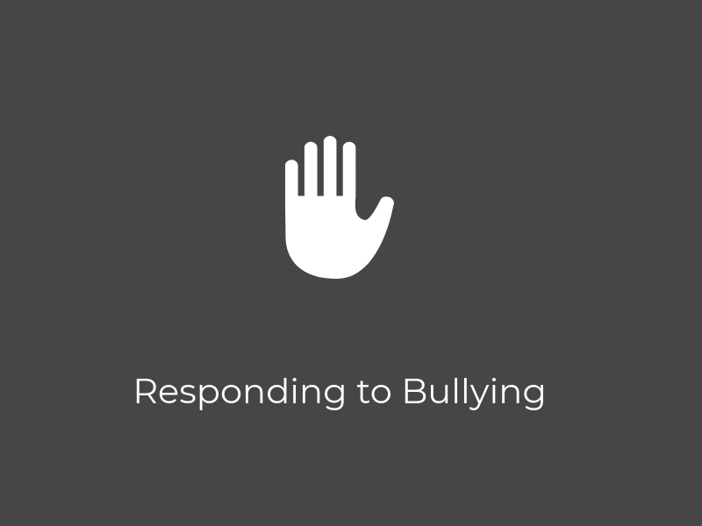

Slide 16
Responding to Bullying ^{[5]}
71% of employer reactions and 60% of coworker reactions to bullying are harmful to targets.

Slide 17
Responses that Encourage Bullying
Praising bullies’ achievements or work-ethic
Awarding promotions or raises to employees who bully
Failing to address bullying
Assuming it will sort itself out

Slide 18
Responding to Bullying: A Trauma-Informed Approach
Start with “I believe you”
It’s common to want to solve the problem first
Targets feel more empowered when they are believed
Victims who are not believed when the report experience more negative mental health symptoms than those who are believed

Slide 19
Responding to Bullying: A Trauma-Informed Approach
Be willing to be an advocate for the target
Inform them of what the process is and any limitations i.e. “I can’t suspend this person at this time.” “We need to start a write-up first.”
Helpful for coping
Be timely in your response and investigation

Slide 20
Addressing Bullying as an Organization
Address under-reporting by implementing a co-worker observation reporting system (CORS)
CORS aim to encourage respect and accountability while ensuring consistent and timely reporting. ^{[10]}
Notes:
Does anyone currently implement a CORS, how has that impacted bullying at your organization?

Slide 21
Joint Commission Suggested Actions for Addressing Bullying ^{[8]}
Establish norms/culture that does not tolerate bullying
Confront bullies and support targets
Educate all team members on appropriate behaviors that are consistent with the code of conduct
Hold all team members accountable

Slide 22
Joint Commission Suggested Actions for Addressing Bullying ^{[8]}
5. Develop and enforce policies that address:
Bullying
Reducing fear of retaliation
Responding to patients and families who witness bullying
Disciplinary actions (get input from inter-professional team)

Slide 23
Reasons for the Policy-Practice Gap (i.e. why policies don’t always get enforced)
Reputation
Good Worker
Stereotypes
Fear of being sued
Feeling inadequate
Needing to be liked
Notes:
Explain policy-practice gap then have participants brainstorm reasons for this gap.

Slide 24
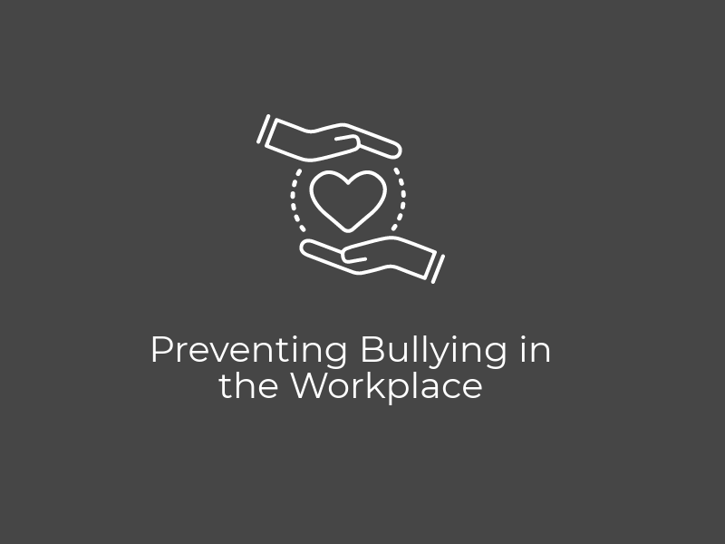

Slide 25
Strategies for Preventing Bullying
Promote a culture of safety for all ^{[11]}
Incorporate teambuilding or social actives into regular meetings
Builds a collegial atmosphere
Provide training on diversity, stress & anger management, and conflict resolution
Notes:
Time permitting do the “Find a common thread” activity with the group. Discuss how the more we know about our coworkers the more we see their humanity.

Slide 26
Strategies for Preventing Bullying
Preventive education and cognitive rehearsal ^{[12]}
Educate new staff members about how to respond to bullying
Provide training on cognitive rehearsal on how to approach bullies
Findings:
Easier to depersonalize lateral bullying, confront bullies, and learn new skills with less fear
Increased retention of new-hires
Notes:
An option that had positive findings, still puts responsivity on targets to address bullying.
Suggestion: blend this approach with training on diversity, stress, anger management, and resolving conflicts. Make staff aware of workplace bullying policy and make staff aware of consequences.

Slide 28
Resources:
Workplace Bullying Institute
Your organization’s EAP
Yourlifeiowa.org
Crisis Line:
Phone: 855-581-8111
Text: 855-895-8398

Slide 29
References:
http://www.workplacebullying.org/individuals/problem/definition (accessed on 3/1/18)
Image from: http://www.womenhelpingwomenmaui.com/resources/power-wheel-of-abuse/
Rayner C and Hoel H. A summary review of literature relating to workplace bullying. Journal of Community & Applied Social Psychology, 1997;7:181-191
Canadian Centre for Occupational Health and Safety: OSH Answers Fact Sheet https://www.ccohs.ca/oshanswers/psychosocial/bullying.html, (accessed 3/15/2018)
Workplace Bullying Institute U.S. Workplace Bullying Survey, 2017 http://www.workplacebullying.org/wbiresearch/wbi-2017-survey/ (accessed 3/1/18)
Workplace Bullying Institute U.S. Workplace Bullying Survey, 2007 http://www.workplacebullying.org/medical-workplace/ (accessed 3/1/18)
Meissner JE.,Nurses: Are we eating our young, Nursing, 1996; 16(3):51-3
Joint Commission, Quick Safety: Bulling has no place in health care; 2016 (24)
Workplace Bullying Institue, http://www.workplacebullying.org/individuals/problem/how-bullying-happens/ (accessed 2/15/2018)
Hickson GB, et al., Using coworker observations to promote accountability for disrespectful and unsafe behaviors by physicians and advanced practice professionals. The Joint Commission Journal of Quality and Patient Safety, 2016; 42:149-161
O’Donnell J and Unger L., ‘Disruptive’ doctors rattle nurses, increase safety risks. USA Today, Sept. 30, 2015
Griffin M. Teaching cognitive rehearsal. Journal of Continuing Education in Nursing, Nov.-Dec. 2004;35(6):257-263

