Slide 1
Just Press Pause
Kristin L. Flood, RN, BS

Slide 2
Objectives
Describe ways to become a more effective listener.
Identify how to quickly shift focus and perspectives.
Define how to address multiple and differing priorities simultaneously.
Describe how to stay calm in chaos.

Slide 3
PAUSE??

Slide 4
Inspiration
Practice the Pause:
Pause before judging. Pause before assuming. Pause before accusing. Pause whenever you’re about to react harshly and you’ll avoid doing and saying things you’ll later regret.
Lori Deschene

Slide 5
PAUSE EXAMPLES
Time out
Sit vs stand to speak with patient
Listen
Deep breathe, count to 3 or 1,000.
Self Awareness
Mindfulness
Being in the present moment
Focused
Shifting Perspectives
Meditation

Slide 6
Challengesand Benefits

Slide 7
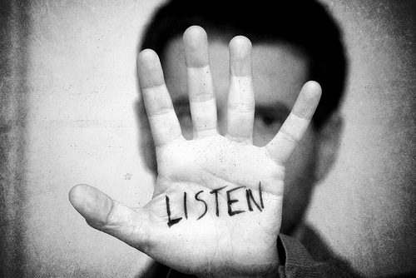

Slide 8
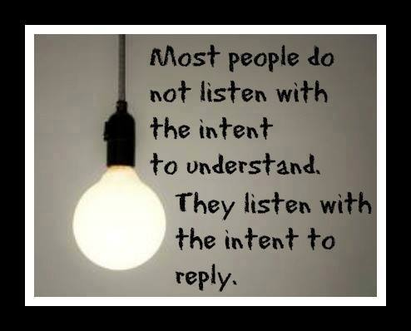
Listening during conflict

Slide 9
Listening Tips/Strategies
Be fully present
Don’t make assumptions
Don’t focus on who is right/wrong
Listen, don’t think of your response
Ask questions to clarify
Use “I see” , “I understand”

Slide 10
Calm in Chaos

Slide 11
Just Press pause

Slide 12
Respond vs. React

Slide 13
REACT: An expression of emotions without thought
RESPOND: A thoughtful expression

Slide 14
Identify your own Buttons or Triggers!
Self Awareness

Slide 15
Mindfulness
Emotional Intelligence
Self Awareness
Present Moment
FOCUS

Slide 16
DEFINITIONS
a mental state achieved by focusing one's awareness on the present moment, while calmly acknowledging and accepting one's feelings, thoughts, and bodily sensations, used as a therapeutic technique = MINDFULNESS
Daniel Goleman, the guru of emotional intelligence, identified self-awareness as being made up of emotional awareness, accurate self-assessment, and self-confidence. In other words, it is all about knowing your emotions, your personal strengths and weaknesses, and having a strong sense of your own worth.
the capacity to be aware of, control, and express one's emotions, and to handle interpersonal relationships judiciously and empathetically= EMOTIONAL INTELLIGENCE
your awareness is completely centered on the here and now. You are not worrying about the future or thinking about the past. When you live in the present, you are living where life is happening. The past and future are illusions, they don't exist = PRESENT MOMENT
Directing attention toward where it needs to go. Three areas of focus: self (inner), people (other), and system (outer) awareness. Inner focus attunes us to our emotions and intuitions, guiding values and better decisions.

Slide 17
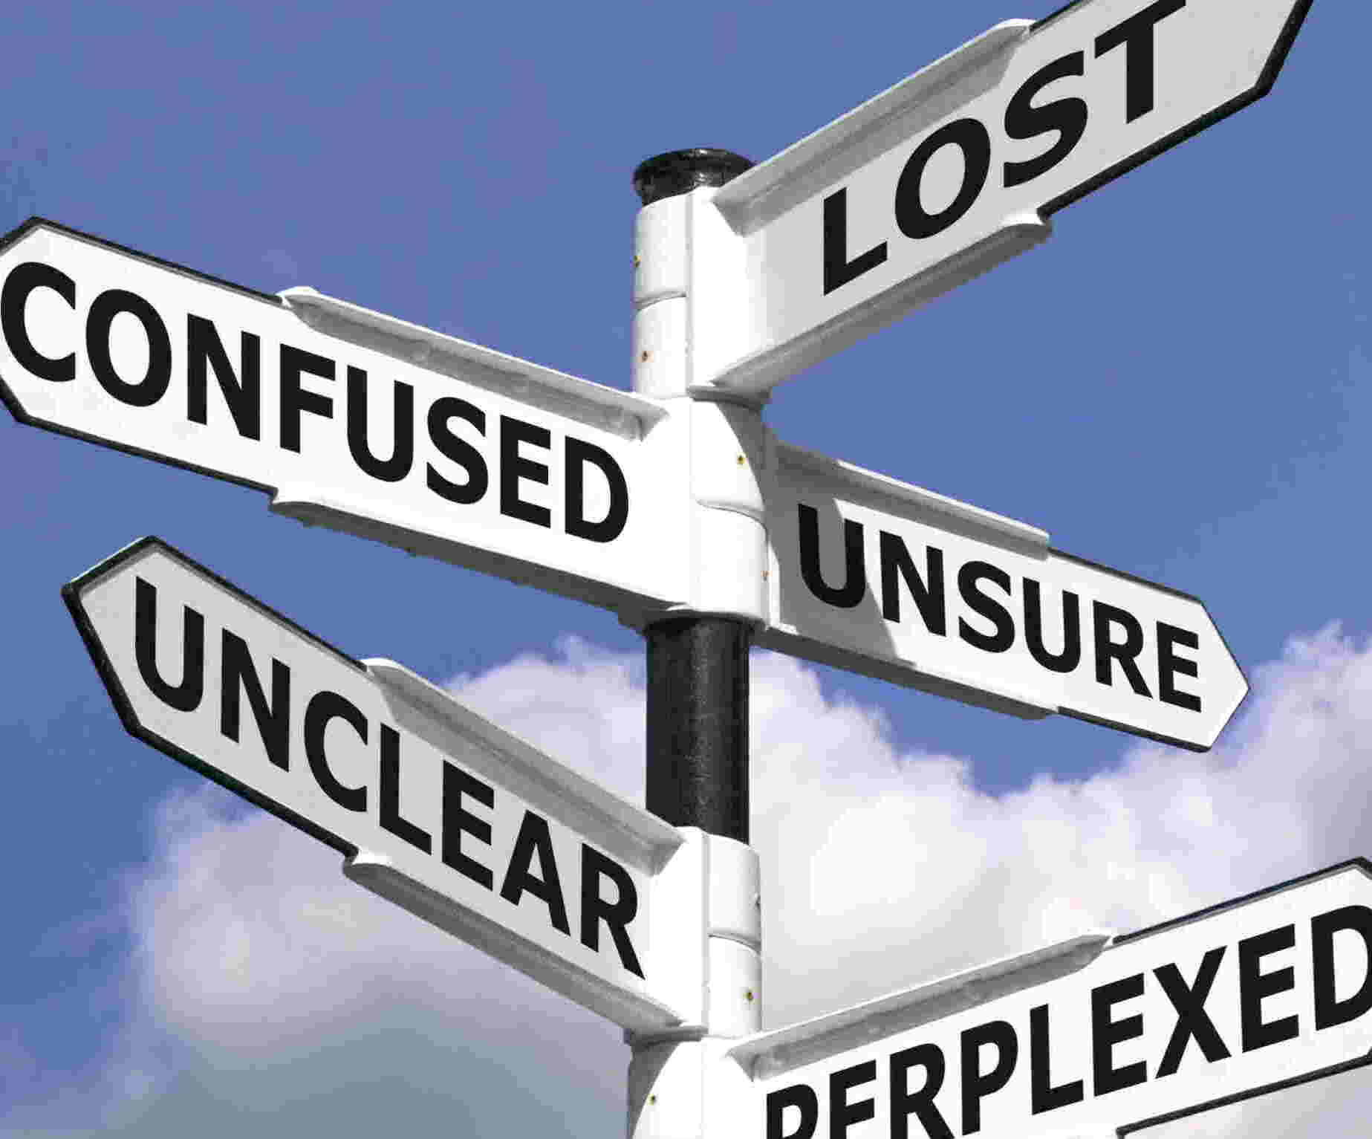

Slide 18
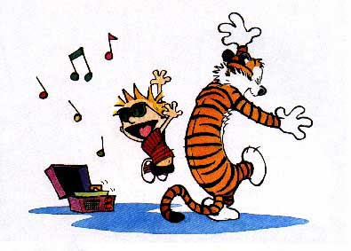
OUTCOMES

Slide 19
How?

Slide 20
Highly Emotionally Intelligent Individuals rarely:
Overly dramatic
Complain
Negative
Selfish
Give into Peer Pressure
Overly Critical

Slide 21
Goal is Self Awareness
Self aware people choose the most skillful behavior to navigate through complex situations. Capacity for introspection.
Notice emotions as they occur
Adaptible,flexible, not rigid
Process thoughts before communicating

Slide 22
FOCUS
Focus is a foundational skill for emotional intelligence.
3 Types
Inner
Others
Global
INNER: Focus your attention inward. Become self aware.

Slide 23
a mental state achieved by focusing one's awareness on the present moment, while calmly acknowledging and accepting one's feelings, thoughts, and bodily sensations, used as a therapeutic technique = MINDFULNESS
your awareness is completely centered on the here and now. You are not worrying about the future or thinking about the past. When you live in the present, you are living where life is happening. The past and future are illusions, they don't exist = PRESENT MOMENT

Slide 24
Cultivate Mindfulness
Intentional time to practice
Quiet mind
Let thought roll in without judgement
Practice returning to present

Slide 25
Other ways to Practice
Meditation
Observer position
Body Scan Process
Journal-daily self reflection
Breathe
Ask for feedback
Coaching

Slide 26
Focus on Others and Globally
Focus on Others
Focus Globally
Listen to develop empathy
Connect with others
Shift perspectives easily
No one right answer
Open to new ideas
Deliberate disengagement from default mental habits to focus broadly. Fresh eye perspective

Slide 27
PRACTICE
Practice the Pause:
Pause before judging. Pause before assuming. Pause before accusing. Pause whenever you’re about to react harshly and you’ll avoid doing and saying things you’ll later regret.
Lori Deschene

Slide 28
Thank you!
Kristin L. Flood, RN, BS
kristinfloodinspired@Hotmail.com

Slide 29
Bibliography
Atkinson, Marilyn. Step by Step Coaching. Exalon Publishing, LTD, 2010.
Bariso, Justin. How to Increase Your Emotional Intelligence. www.inc.com. 2018
Bradberry, T, and Graves, J. Emotional Intelligence 2.0. Talentsmart.com 2009.
Goleman, Daniel, PhD. How Focus Changed My Thinking About emotional Intelligence. Psychologytoday.com. 10/2013
Guillaraumie, Laurence, PhD, Boiral, Oliver, PhD, Champagne, Julie, PhD. A Mixed methods Systemic Review of the Effects of Mindfulness on Nurses. John Wiley & Sons Ltd. 2016
Horowitis, Sala. Health Benefits of Meditation:What the Newest research Shows. www.liebertpub.com. 8/2010
Jones, G. The Role of Superior Performance Intelligence in Sustained Success. The Oxford Handbook of Sports Perfomance Psychology. NY, NY. 2012
Kushinir, Lena. Ed.D. Mindfulness in Action: A Skeptics Story. www.gaplesinstitute.org. 2018
Ni, Preston. M.S.B.A. How to Increase Your Emotional Intelligence-6 Essentials. Psychology Today.com. 10/2014.

